Slide 1
Rising Rates and housing Impact
6-8 visualizations of data
Slides are visually clean and professional
Slides are relevant to material
Slides effectively demonstrate the project
Slides are clear and maintain audience interest
About 7 minutes for presentation
Justin Bernier, Ankita Sarkar, Kim Sernett

Slide 2
INTRODUCTION
Our objective is to see if the changes in the federal funds rates and mortgage rates are having an impact on the real estate markets in the Austin area. Impacts we focused on included housing sale prices, number of days on the market, and whether homes are being sold above or below listing price.

Slide 3
Data Collection
Data sources
Merging data
Data was narrowed down to most recent 10 years

Slide 4
Graph 1
​ | CATEGORY 1 | CATEGORY 2 | CATEGORY 3​ | CATEGORY 4​
Q1 | 4.5​ | 2.3​ | 1.7​ | 5​.0
Q2 | 3.2​ | 5.1​ | 4.4​ | 3​.0
Q3 | 2.1​ | 1.7​ | 2.5​ | 2.8​
Q4 | 4.5​ | 2.2​ | 1.7​ | 7.0

Slide 5
Graph 2
​ | CATEGORY 1 | CATEGORY 2 | CATEGORY 3​ | CATEGORY 4​
Q1 | 4.5​ | 2.3​ | 1.7​ | 5​.0
Q2 | 3.2​ | 5.1​ | 4.4​ | 3​.0
Q3 | 2.1​ | 1.7​ | 2.5​ | 2.8​
Q4 | 4.5​ | 2.2​ | 1.7​ | 7.0

Slide 6
Graph 3
​ | CATEGORY 1 | CATEGORY 2 | CATEGORY 3​ | CATEGORY 4​
Q1 | 4.5​ | 2.3​ | 1.7​ | 5​.0
Q2 | 3.2​ | 5.1​ | 4.4​ | 3​.0
Q3 | 2.1​ | 1.7​ | 2.5​ | 2.8​
Q4 | 4.5​ | 2.2​ | 1.7​ | 7.0

Slide 7
Graph 4
​ | CATEGORY 1 | CATEGORY 2 | CATEGORY 3​ | CATEGORY 4​
Q1 | 4.5​ | 2.3​ | 1.7​ | 5​.0
Q2 | 3.2​ | 5.1​ | 4.4​ | 3​.0
Q3 | 2.1​ | 1.7​ | 2.5​ | 2.8​
Q4 | 4.5​ | 2.2​ | 1.7​ | 7.0

Slide 8
Graph 5
​ | CATEGORY 1 | CATEGORY 2 | CATEGORY 3​ | CATEGORY 4​
Q1 | 4.5​ | 2.3​ | 1.7​ | 5​.0
Q2 | 3.2​ | 5.1​ | 4.4​ | 3​.0
Q3 | 2.1​ | 1.7​ | 2.5​ | 2.8​
Q4 | 4.5​ | 2.2​ | 1.7​ | 7.0

Slide 9
Graph 6
​ | CATEGORY 1 | CATEGORY 2 | CATEGORY 3​ | CATEGORY 4​
Q1 | 4.5​ | 2.3​ | 1.7​ | 5​.0
Q2 | 3.2​ | 5.1​ | 4.4​ | 3​.0
Q3 | 2.1​ | 1.7​ | 2.5​ | 2.8​
Q4 | 4.5​ | 2.2​ | 1.7​ | 7.0

Slide 10
Graph 7
​ | CATEGORY 1 | CATEGORY 2 | CATEGORY 3​ | CATEGORY 4​
Q1 | 4.5​ | 2.3​ | 1.7​ | 5​.0
Q2 | 3.2​ | 5.1​ | 4.4​ | 3​.0
Q3 | 2.1​ | 1.7​ | 2.5​ | 2.8​
Q4 | 4.5​ | 2.2​ | 1.7​ | 7.0

Slide 11


Slide 12
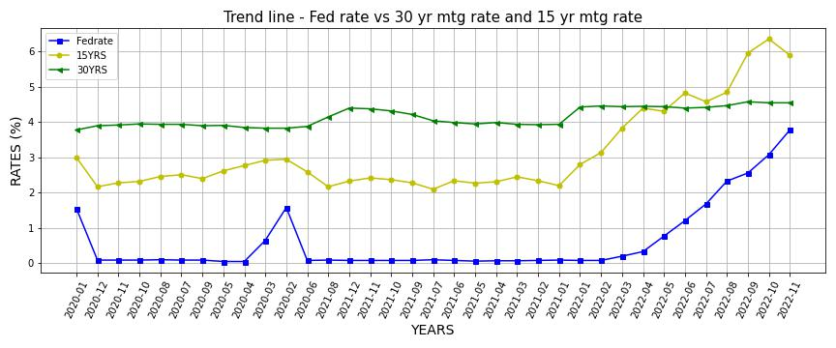

Slide 13
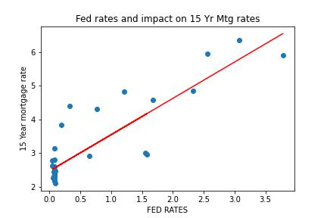
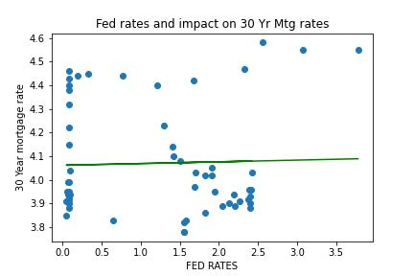
Correlation of Fed Rates and 15yr & 30YR mtg rates
R-value = 0.87
R-value = 0.03

Slide 14
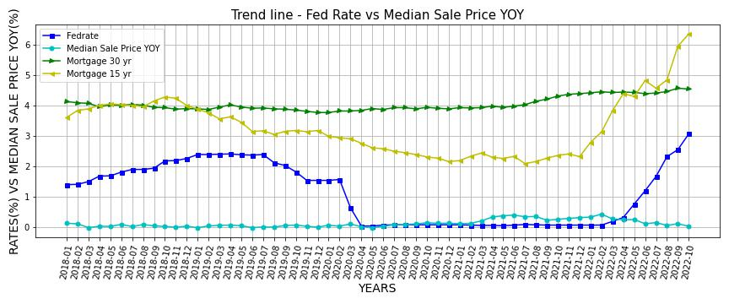

Slide 15
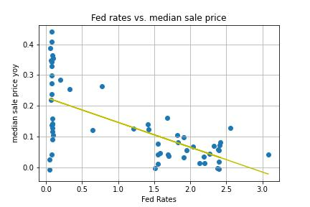

Slide 16
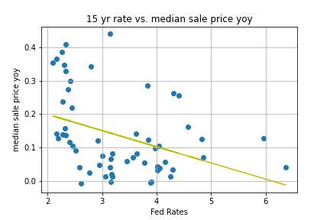

Slide 17
SUMMARY
Summary 1
Summary 2
Summary 3

Slide 18
Thank you!

